Slide 1

My Linear Relationships Interactive Notebook
Name
Class
Teacher
Semester 2
Term 4
1

Slide 2

Interactive Notebooks!
Cover Page
Contents Page
Glossary
24/7/30
EQ
Questions
Notes
Summaries
Work page
Presentation!!!
Your book, your responsibility!

Slide 3
Contents
Glossary or Formula Page
Page
Date
Description
For example
Linear: ___________
Origin: ___________
Coordinates: __________
2
3

Slide 4

24
7
30
Tasks
24
7
30
Essential Question
Complete the tasks on this side (left) of your page
You should be ticking these off!
Questions
Notes
Write your notes on this side (right) of your page
Summary
Have YOU been doing your summaries?
Your book, your responsibility!

Slide 5
For this activity you will need: a whiteboard and a marker to record your answers
(or something similar if not available)
You will need to record which answers you get right and the dollar value associated with each answer.
The person with the most money at the end wins!

Slide 6


Plenary
1,000,000
900,000
800,000
700,000
600,000
500,000
400,000
300,000
200,000
What is the mathematical keyword used to describe the
slope (flatness and steepness) of a linear graph?
100,000
A origin
B intercept
C gradient
C gradient
D x-axis

Slide 7
Plenary
1,000,000
900,000
800,000
700,000
600,000
500,000
400,000
300,000
200,000
100,000
Linear graphs are :
100,000
A straight lines
A straight lines
B circles
C curves
D none of the above

Slide 8
Plenary
1,000,000
900,000
800,000
700,000
600,000
500,000
400,000
300,000
200,000
200,000
Look at y = 3x + 1. What is the value of the gradient?
100,000
A 1
B 4
C 2
D 3
D 3

Slide 9
Plenary
1,000,000
900,000
800,000
700,000
600,000
500,000
400,000
300,000
300,000
200,000
What is the mathematical keyword used to describe
where a linear graph crosses the y-axis?
100,000
A parallel
B intercept
B intercept
C gradient
D x-axis

Slide 10
Plenary
1,000,000
900,000
800,000
700,000
600,000
500,000
400,000
400,000
300,000
200,000
Which pair of linear graphs have the same gradient (slope)?
100,000
A y = 2x + 1 & y = 3x + 1
B y = 3x + 2 & y = 3x +3
B y = 3x +2 & y = 3x +3
C y = x - 2 & y = 2x + 5
D all of the above

Slide 11
Plenary
1,000,000
900,000
800,000
700,000
600,000
500,000
500,000
400,000
300,000
200,000
Look at y =x + 1. When x is 3, what would y be?
100,000
A 4
A 4
B 1
C 3
2

Slide 12
Plenary
1,000,000
900,000
800,000
700,000
600,000
600,000
500,000
400,000
300,000
200,000
What is the name of the point where the x-axis and
the y axis meet?
100,000
A origin
A origin
B intercept
C slope
D parallel

Slide 13
Plenary
1,000,000
900,000
800,000
700,000
700,000
600,000
500,000
400,000
300,000
200,000
When linear graphs cross the y - axis at different points,
we say the graphs have the different………
100,000
A origins
B intercepts
B intercepts
C gradients
D lengths

Slide 14
Plenary
1,000,000
900,000
800,000
800,000
700,000
600,000
500,000
400,000
300,000
200,000
Look at y = 2x + 2. If x is 7, what would y be?
100,000
A 2
B 7
C 14
C 16
D 16

Slide 15
Plenary
1,000,000
900,000
900,000
800,000
700,000
600,000
500,000
400,000
300,000
200,000
When a linear graph slopes downwards from left
to right, it means the gradient is……….
100,000
A 0
B positive
C negative
C negative
D none of the above

Slide 16
Plenary
1,000,000
1,000,000
900,000
800,000
700,000
600,000
500,000
400,000
300,000
200,000
Look at y = -2x – 2. If x is 10, what would y be?
100,000
A -10
B -2
C -18
C -22
D -22

Slide 17
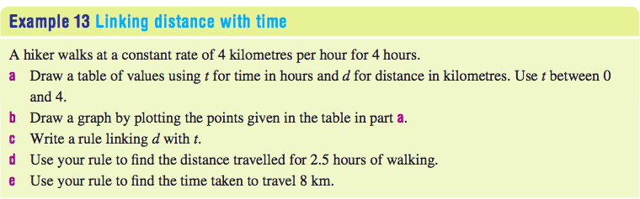

24
7
30
Date
Linear Relationships
EQ – How do we solve real-world linear applications?

Slide 18
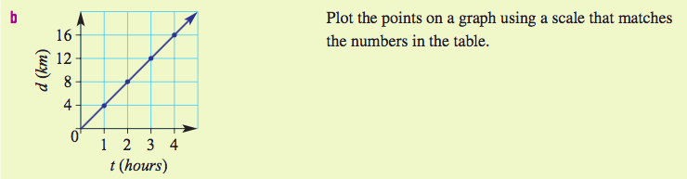
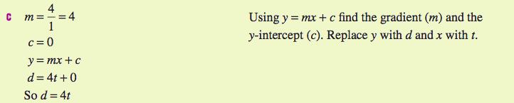
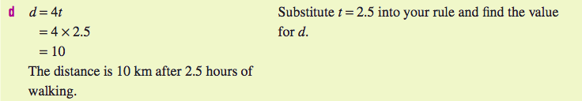

24
7
30
Date
Linear Relationships
EQ – How do we solve real-world linear applications?

Slide 19
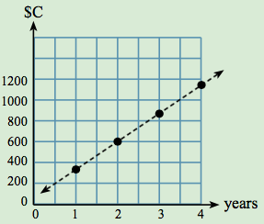





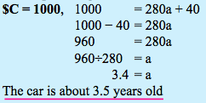

24
7
30
Date
Linear Relationships
EQ – How do we solve real-world linear applications?
Take the following table of values…

Slide 20
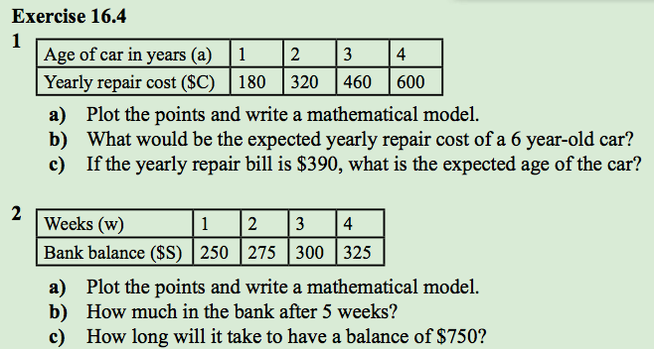
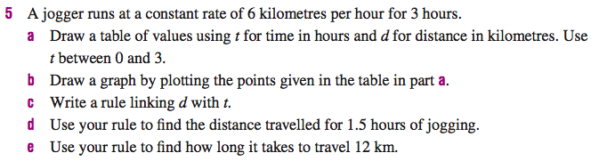
Application

Slide 21
Learning Logs
In the LHS of your INB, write at least 5 sentences on what you’ve learned about Linear Relationships so far:
What does gradient mean?
what is the coefficient and constant and how do they relate to gradient and y-intercept?
What is the proper form for writing linear rules?
Etc……

